Slide 1
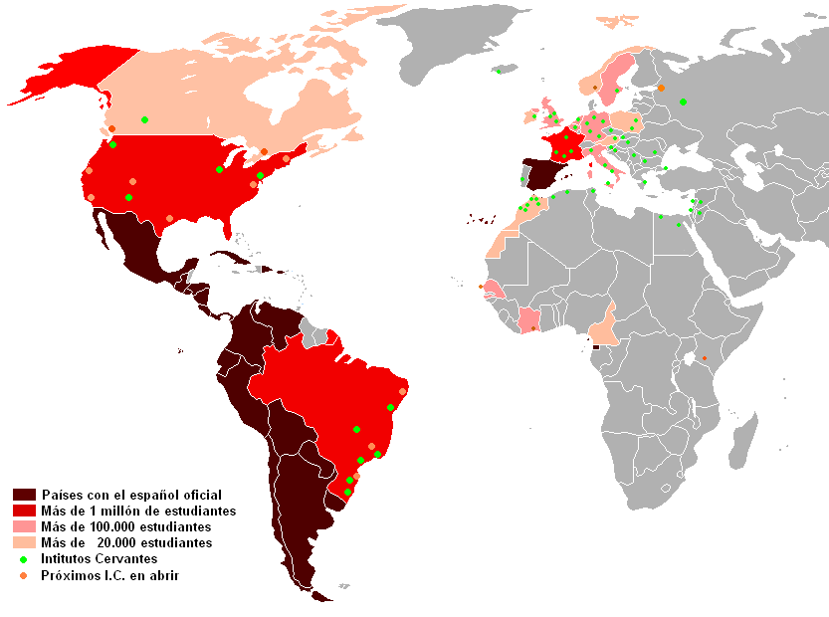
Spanish Reading Club
Time and location of your club
Easy-to-read books for any level!
Free snacks!
Put your logo here!

